Slide 1
Robot Modelling
Mini challenge 1

Slide 2
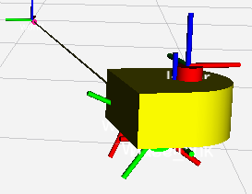
Introduction
Introduction
This mini challenge is intended for the student to review the concepts introduced in the previous sessions.
The activity consists of modelling a differential drive robot in RVIZ.
The robot must be modelled using only ROS markers.
The robot must be modelled using the tf2 library of ROS.
Mini-challenge

Slide 3
Robot modelling
Make a new package called “simple_mobile_robot”, with the following packages
rospy, std_msgs, tf2_ros, visualization_msgs tf_conversions, geometry_msgs
Use transformations and different markers to build a simple mobile robot (differential drive).
The robot must contain a chassis, two wheels and a caster ball.
The student must use various shapes of markers to create their optimal robot.
Front View
Back View

Slide 4
Robot modelling
The expected transformations are represented on the right diagram.
world: fixed frame
base_link: robot pose representation in the 2D (x,y plane).
chassis: link representing the chassis centre.
wheel_r, wheel_l: wheel link
caster: caster ball link.
world
dynamic tf
base_link
static tf
dynamic tf
chassis
static tf
dynamic tf
wheel_r
wheel_l
caster

Slide 5
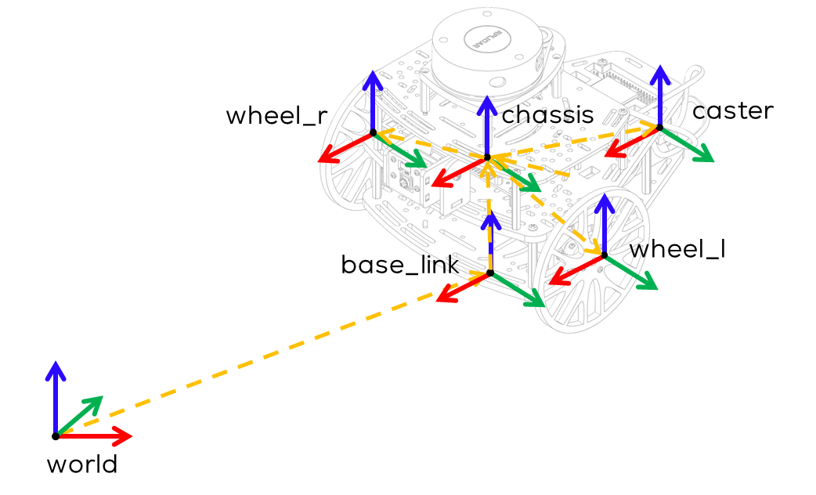
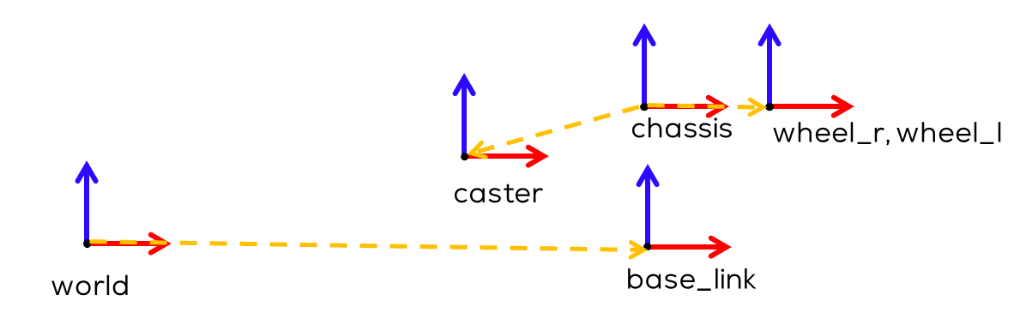
Robot modelling
Side View

Slide 6
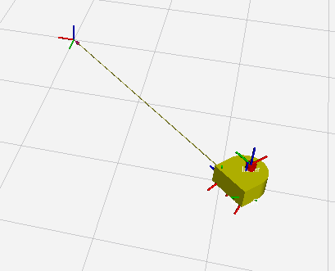
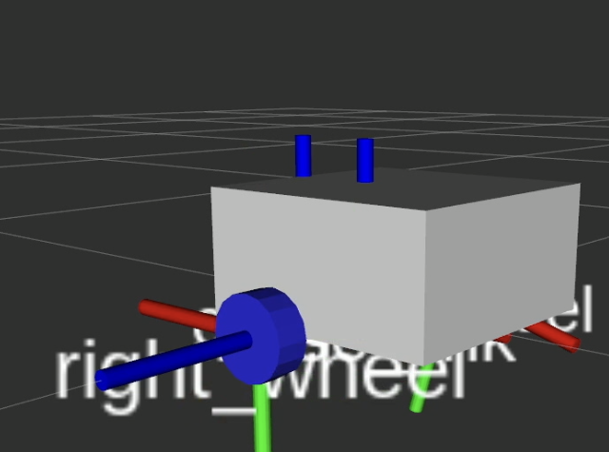
Expected results
The robot should spawn in the RVIZ world.
The robot should be able to move around a central position.
If possible, move the wheels.

